Slide 1

CS1951 L
Blockchains & Cryptocurrencies
Spring 2024
Lecture 20
Cross-chain Transactions
Maurice Herlihy
Brown University

Slide 2
Previous Lecture: Hashed Timelock Contracts

Slide 3
This Lecture: Cross-Chain Messaging Token Bridges Cross-Chain Atomicity

Slide 4
Cross-Chain Messaging

Slide 5
Cross-Chain Messaging
I, Alice just finalized valid txn T
I, Bob, believe Alice finalized txn T

Slide 6
Ethereum Events
An event is a public record that something happened
event Deposit(address from, uint value);
…
emit Deposit(msg.sender, msg.value);
Recorded in Merkle tree in public
Transaction Receipt

Slide 7
txn
event
Relay
txn
trust me
source chain
dest chain

Slide 8
txn
Relay
sigs
txn
event
event
Relay
Relay
source chain
dest chain
Relay
Threshold number of validator sigs

Slide 9
Cross-Chain Messaging
Many possible x-c event xfer protocols
Different security, efficiency
Examples later

Slide 10
Example: Axelar X-C Messaging
Axelar
“instant finality” delegated PoS chain
All X-C communication through Axelar chain

Slide 11

Axelar Validators
Axelar
Users elect validators
Validators stake bonds for good behavior
Re-elected at regular intervals
Vote proportional to bond

Slide 12
Validators do BFT for Chain
Axelar

Slide 13

Validators do Threshold Sigs
Percent of validators construct signature
Axelar
(90% recommended)
Generate: about 10 rounds
Check: << O(#signers)
Sigs checked by participating chains

Slide 14
Validators Snoop on Other Chains via Light Clients
Axelar
Other chain

Slide 15
Cross-Chain Query

Slide 16
X-C Query is Posted
Axelar
When did T happen on S?
Source
Destination

Slide 17
Validators Notice Query
When did T happen on S?
When did T happen on S?
When did T happen on S?
When did T happen on S?
When did T happen on S?
When did T happen on S?
When did T happen on S?
When did T happen on S?
When did T happen on S?
When did T happen on S?
When did T happen on S?
When did T happen on S?
Axelar
When did T happen on S?
Source
Destination

Slide 18
Validators Run Query on Local Light Client
At Block 25!
At Block 25!
At Block 25!
At Block 25!
At Block 25!
At Block 25!
At Block 25!
At Block 25!
At Block 25!
At Block 25!
At Block 25!
At Block 25!
Axelar
When did T happen on S?
Source
Destination

Slide 19
Validators Vote & Threshold Sign & Post on Axelar
At Block 25!
Axelar
(11 rounds later)
When did T happen on S?
Source
Destination

Slide 20
“Anyone” can now send Answer to Destination Chain
At Block 25!
At Block 25!
Axelar
When did T happen on S?
Source
Destination

Slide 21
Threshold Signature Closes the Deal
At Block 25!
Axelar
When did T happen on S?
I believe because of threshold sig
At Block 25!
Source
Destination

Slide 22
Token Bridges

Slide 23
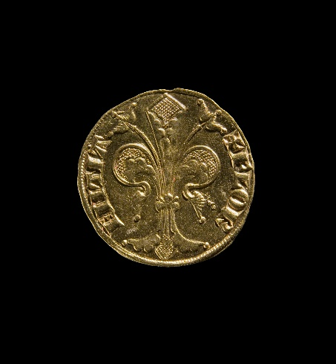
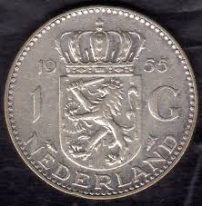
Florin
Guilder
Alice:
Bob:
Alice:
Bob:

Slide 24

Florin
Guilder
Alice:
Bob:
Alice:
Bob:
Freeze
florin

Slide 25
Florin
Guilder
Alice:
Bob:
Alice:
Bob:
Proof of freeze

Slide 26
Florin
Guilder
Alice:
Bob:
Alice:
Bob:
Alice:
Bob:
Proof of freeze
Mint
“wrapped”
florin

Slide 27
Florin
Guilder
Alice:
Bob:
Alice:
Bob:
Alice:
Bob:
“wrapped” florin is a token on Guilder BC

Slide 28
Florin
Guilder
Alice:
Bob:
Alice:
Bob:
Alice:
Bob:
Cross-chain
invariant
1 frozen florin here
1 wrapped florin here

Slide 29
Florin
Guilder
Alice:
Bob:
Alice:
Bob:
Alice:
Bob:
trade

Slide 30
Florin
Guilder
Alice:
Bob:
Alice:
Bob:
Alice:
Bob:

Slide 31

Florin
Guilder
Alice:
Bob:
Alice:
Bob:
Alice:
Bob:
Burn
wrapped
florin

Slide 32
Florin
Guilder
Alice:
Bob:
Alice:
Bob:
Alice:
Bob:
Proof of xfer & burn

Slide 33
Florin
Guilder
Alice:
Bob:
Alice:
Bob:
Alice:
Bob:
Proof of xfer & burn

Slide 34
Florin
Guilder
Alice:
Bob:
Alice:
Bob:
Alice:
Bob:

Slide 35
Florin
Guilder
Alice:
Bob:
Alice:
Bob:
Alice:
Bob:

Slide 36
Florin
Guilder
Alice:
Bob:
Alice:
Bob:
Alice:
Bob:

Slide 37
Florin
Guilder
Proof
Proof
Token Bridge

Slide 38
Florin
Guilder
Proof
Proof
Centralized
Exchange

Slide 39
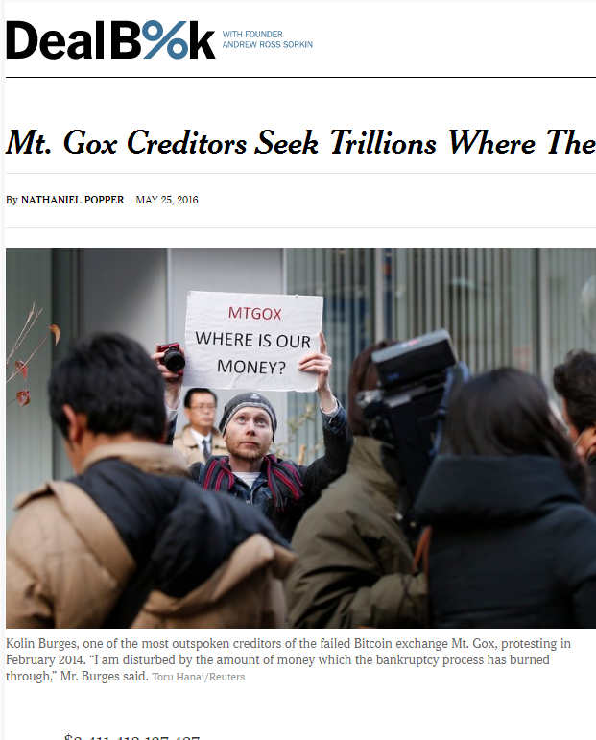
Florin
Guilder
Proof
Proof
Centralized
Exchange

Slide 40
Florin
Guilder
Proof
trustee
Proof
trustee
trustee
m out of n signatures
trustee
trustee
Slashing incentives?

Slide 41

Cosmos’s Gravity Bridge
Between Ethereum & Cosmos
140 validators
Smart Contract on Ethereum side
Bad validators punished by “slashing”
Batching reduces gas costs

Slide 42
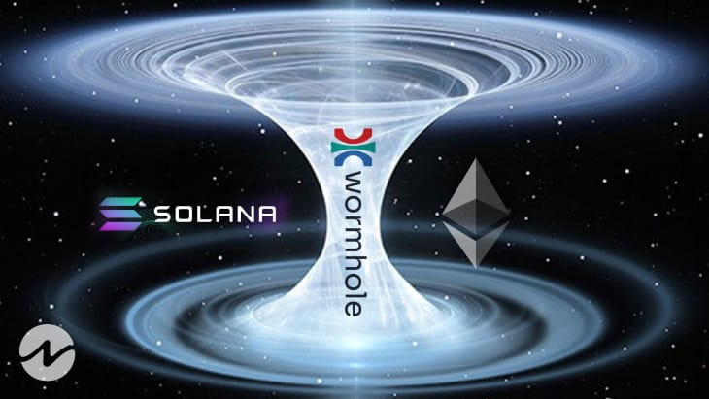
Solana’s Wormhole Bridge
Generic Message-Passing protocol
Transfer message indicates lockup
Attestation message from validator
Fees paid from tokens transferred
Also NFT version

Slide 43
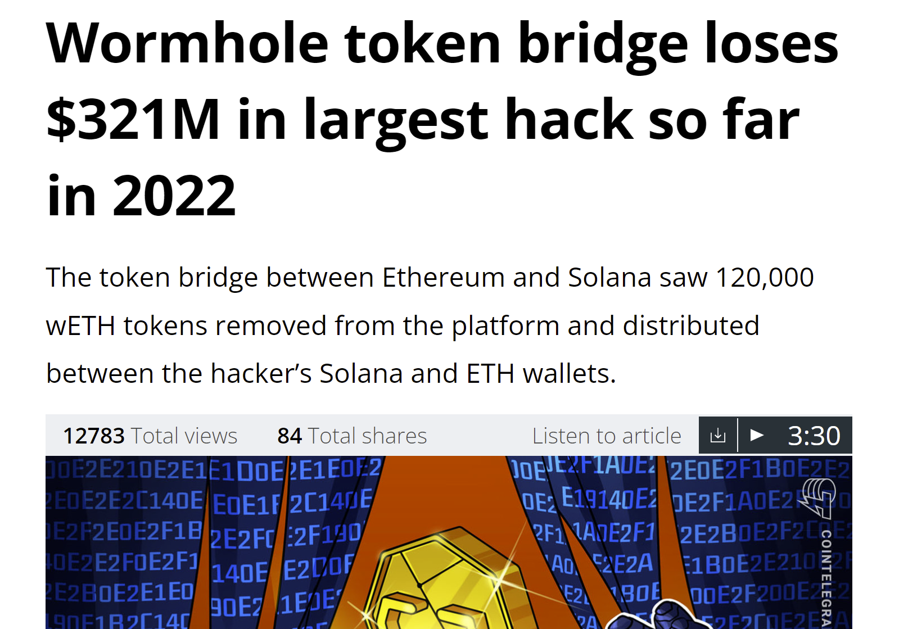
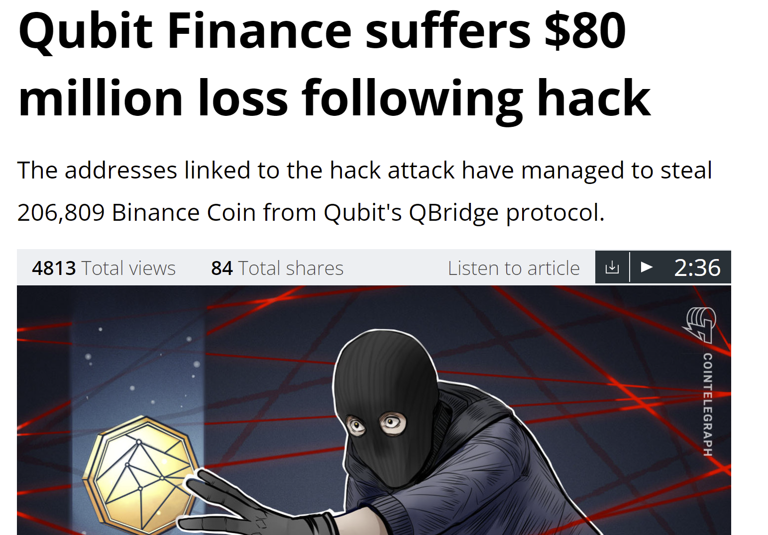
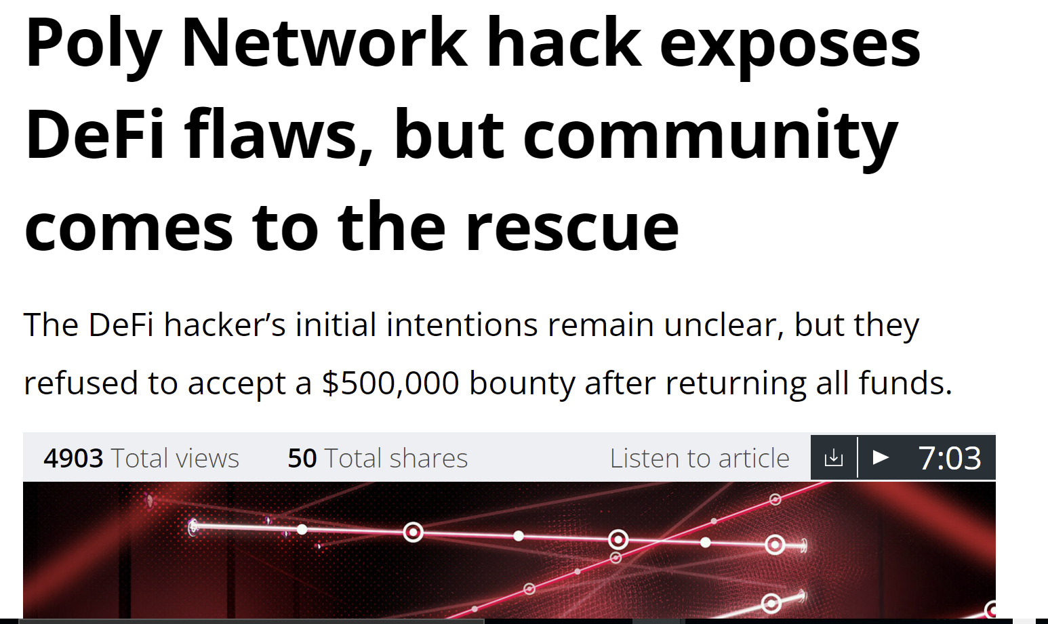
Reasons often obscure …
Contract bugs allow minting of fake wrapped tokens?
Multi-sig keys compromised?

Slide 44
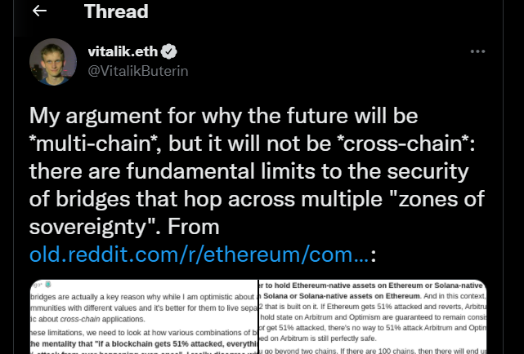
Why Vitalik is not a Fan

Slide 45

Ethereum 51% Attack!
Can censor or record txns …
But cannot steal your coins/tokens
Can revert app calls …
But cannot produce inconsistencies

Slide 46
Florin
Guilder
Alice:
Eve:
Alice:
Eve:
1-1 frozen vs wrapped invariant holds

Slide 47
Florin
Guilder
Alice:
Eve:
Alice:
Eve:
51% attack!
1-1 frozen vs wrapped invariant holds

Slide 48
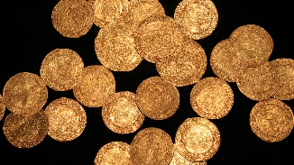
Florin
Guilder
Alice:
Eve:
Alice:
Eve:
1-1 frozen vs wrapped invariant holds

Slide 49
Florin
Guilder
Alice:
Eve:
Alice:
Eve:
1-1 frozen vs wrapped invariant holds

Slide 50
Florin
Guilder
Alice:
Eve:
Alice:
Eve:
Revert!!!
Commit!!!
Oopsie!

Slide 51
51%-Attacked chain
Honest Chains
Contagion via
token bridge !
HTLCs and optimistic rollups unaffected

Slide 52

HTLCs vs Token Bridges
Bridges arguably more efficient
Used more in practice
But centralization issues
Recent security problems
More research needed

Slide 53
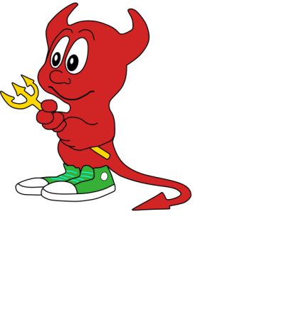
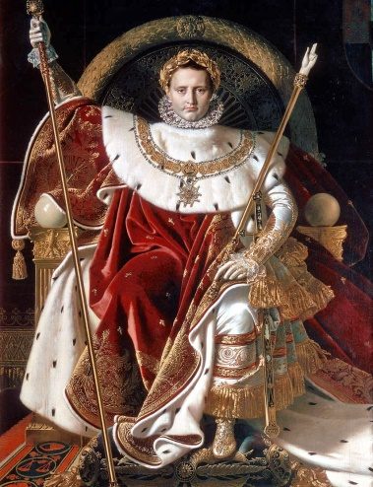
Classical Distributed Computing
versus
trusted
central
coordinator
Crash failures,
Lost messages …

Slide 54



B
A
DB
DB
C
DB

Slide 55

Lock your assets!
B
A
DB
DB
C
DB

Slide 56
Lock your assets!
B
A
DB
DB
C
DB

Slide 57
Record intentions on stable storage!
B
A
DB
DB
C
DB

Slide 58
Prepare your transfers!
OK
OK
B
A
DB
DB
OK
C
DB

Slide 59
Commit!
Done!
Done!
B
A
DB
DB
Done!
C
DB

Slide 60

Classical “ACID” Properties
Atomicity
Consistency
Isolation
Durability

Slide 61
“ACID” Properties
Atomicity
Consistency
All or nothing:
either everyone trades, or no one trades
Isolation
Durability

Slide 62
“ACID” Properties
Atomicity
Consistency
Internal invariants preserved:
e.g., no money created or destroyed
Isolation
Durability

Slide 63
“ACID” Properties
Atomicity
Consistency
Isolation
No transaction sees another’s intermediate inconsistent states
Durability

Slide 64
“ACID” Properties
Atomicity
Consistency
Isolation
Transaction effects survive crashes
Durability

Slide 65

“ACID” Properties
I laugh at your inadequate notions of correctness
Atomicity
Consistency
Isolation
Durability
blockchain world

Slide 66
“ACID” Properties
Atomicity
Consistency
Isolation
All or nothing property impossible to guarantee
Durability

Slide 67
Irrational Behavior
Reveal s
prematurely
A
B
No Cadillac for you!
C

Slide 68
Can’t happen here because there are no Byzantine failures
B
A
DB
DB
C
DB

Slide 69
New “ACID” Properties
Atomicity
Consistency
Isolation
Durability
Need to split classical atomicity into safety and liveness properties

Slide 70
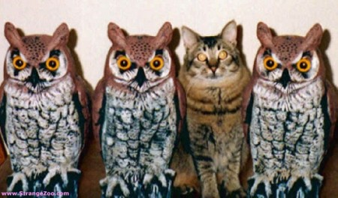
Safety: Even If some parties deviate,
no conforming party is “worse off”
I’m OK
I’m OK
I’m OK
Uh-oh

Slide 71
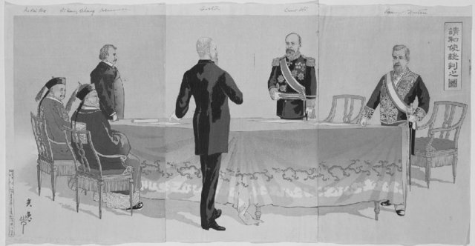
Liveness: If all parties conform, all swaps take place
Done!
Done!
Done!
Done!

Slide 72
New “ACID” Properties
Atomicity
Consistency
Isolation
Durability
If all conform, it happens,
otherwise, conforming parties “no worse off”

Slide 73
“ACID” Properties
Atomicity
Consistency
Isolation
Durability
What does this mean for cross-blockchain transactions?

Slide 74

Strong Nash Equilibrium
Everyone follows one strategy …
But if a coalition deviates…
It won’t improve its payoff
Rational to conform

Slide 75
New “ACID” Properties
Atomicity
Consistency
Isolation
Durability
No coalition has an incentive to deviate.

Slide 76
Classical “ACID” Properties
Atomicity
Consistency
Isolation
Durability
But intermediate states not hidden in swap protocols!

Slide 77

Alice, Bob, and Carol put assets in escrow
A
B
Contract transfers or refunds assets
But escrow should be temporary!
C

Slide 78
New “ACID” Properties
Atomicity
Consistency
Isolation
Safety: once a party escrows assets, it cannot also spend them
Durability

Slide 79
New “ACID” Properties
Atomicity
Consistency
Isolation
Durability
Liveness: escrows are temporary

Slide 80
“ACID” Properties
Atomicity
Is it enough to survive system crashes?
Consistency
Isolation
Durability

Slide 81
Government censorship
Crashes, meh?
Hacker censorship
tampering
disasters

Slide 82
New “ACID” Properties
Immune to tampering and censorship by government, private parties, and natural and man-made disasters
Atomicity
Consistency
Isolation
Durability

Slide 83
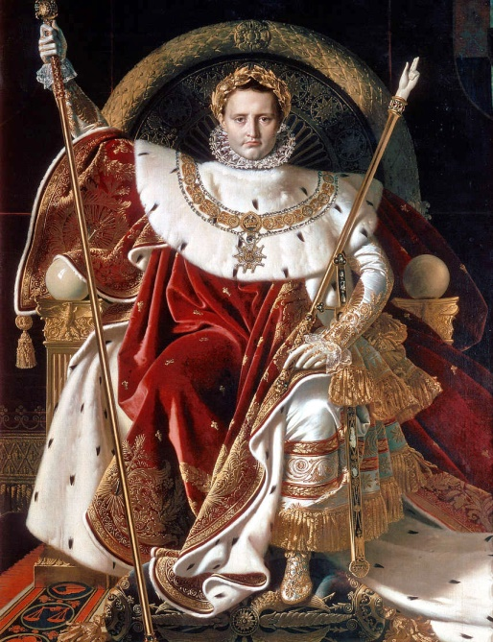
Rethinking Trust
Rethink
Distributed
Computing
blockchain
trusted central
authority

Slide 84
Rethinking Storage
Rethink
Distributed
Computing
Database
or file system
blockchain

Slide 85
What We Said
Rethink
Correctness
“ACID” properties
for distributed
transactions
Revised properties
for cross-chain
transactions

Slide 86
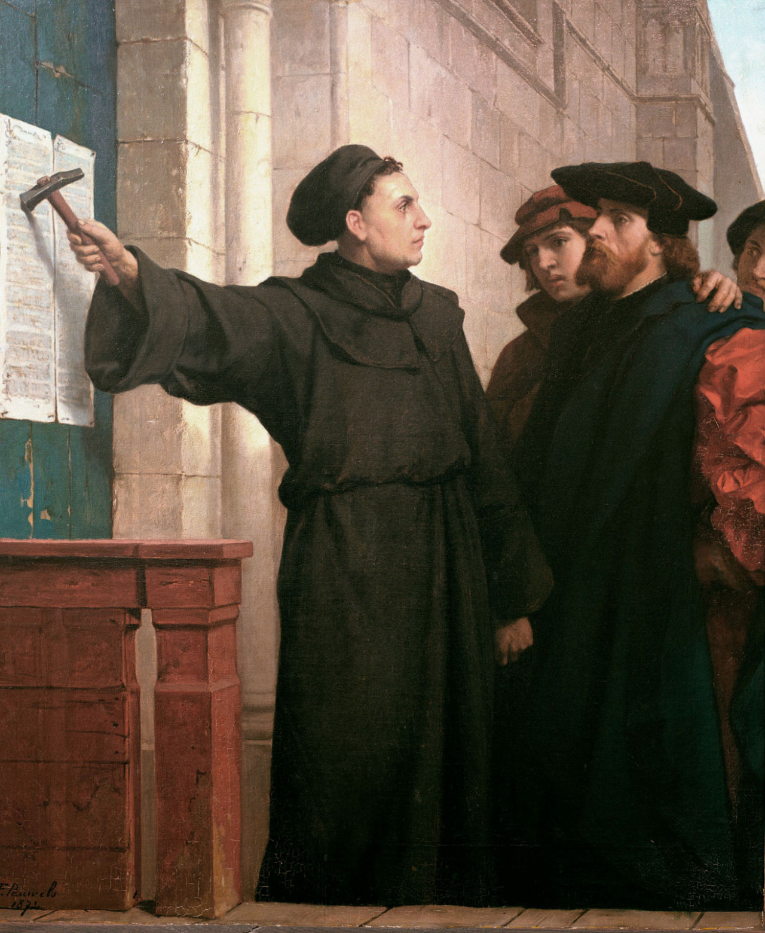
Ideas we covered in these lectures
X-C Messaging
Token Bridges
Security issues with Token Bridges
Classical vs Blockchain ACID properties

